Slide 1
Ergogenic Aids Evaluated

Slide 2
Objectives
Describe the benefits of carbohydrate loading
Describe the negative aspects of carbohydrate loading
Compare and contrast each of the following ergogenic aids
L-carnitine -Creatine
Chromium -Choline
Coenzyme Q10 -Pyruvate

Slide 3

Carbohydrate Loading
Popular method to increase glycogen reserves

Slide 4
Carbohydrate Loading, continued

Slide 5
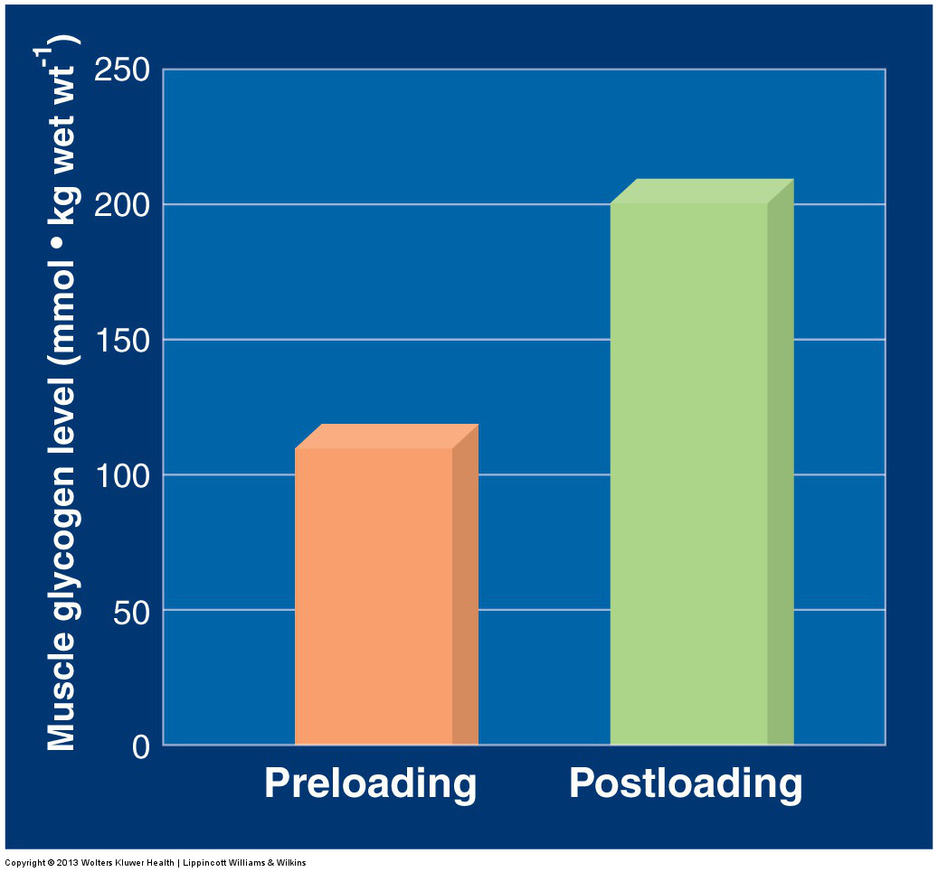

Slide 6
Negative Aspects of Carbohydrate Loading
Negatively affects individuals susceptible to:

Slide 7
Amino Acid Supplementation
Research on healthy subjects does not provide evidence for an ergogenic effect of a general dietary increase of amino acid supplements on:
Hormone secretion
Training responsiveness
Exercise performance

Slide 8
Overview of Various Ergogenic Aids

Slide 9
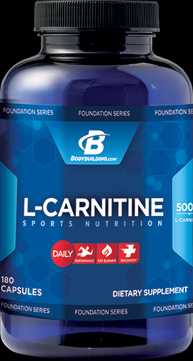
l-Carnitine

Slide 10
l-Carnitine, continued

Slide 11
Benefits of l-Carnitine

Slide 12
Chromium

Slide 13
Negative Effects of Chromium

Slide 14
Coenzyme Q₁₀

Slide 15
Coenzyme Q_{10, continued}
Research has found that coenzyme Q₁₀ does not:

Slide 16
Creatine

Slide 17
Creatine, continued
Supplementation exerts the following 3 effects in individuals involved in power-type physical activities:

Slide 18
Risks Associated With Creatine Supplementation

Slide 19

Choline

Slide 20
Medium-Chain Triacylglycerols

Slide 21
Medium-Chain Triacylglycerol Supplements

Slide 22
(—)-Hydroxycitrate

Slide 23
Pyruvate

